Slide 1
A MACHINE LEARNING APPROACH FOR CLASSIFYING CUISINES
Presented by Plotly

Slide 2
AIM
TO AUTOMATE THE PROCESS OF DETERMINING THE CUISINE OF A RECIPE GIVEN ITS INGREDIENTS

Slide 3
DATA SOURCE
The data was scraped from
www.allrecipes.com
www.epicurious.com
www.menupan.com
by Yong-Yeol Ahn, Sebastian E. Ahnert, James P. Bagrow & Albert-Laszlo Barabasi
in 2011.

Slide 4
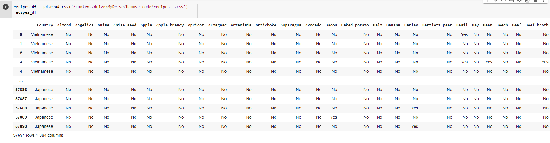
DATA LAYOUT

Slide 5
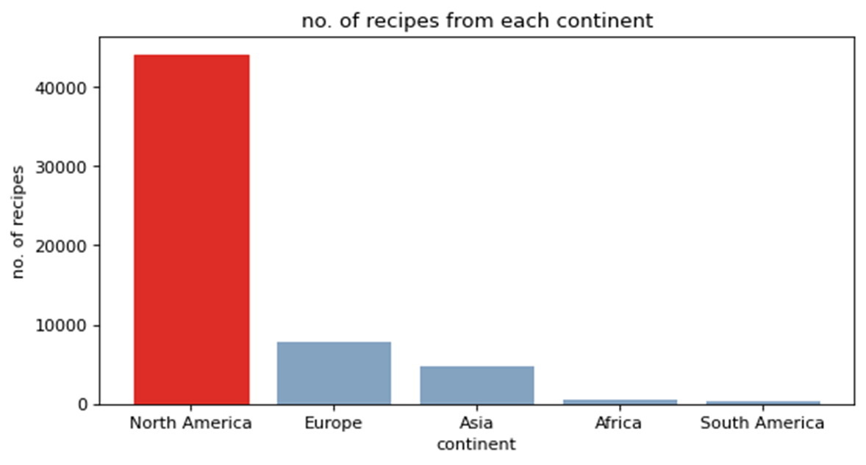
Representation of recipes for each Continent

Slide 6
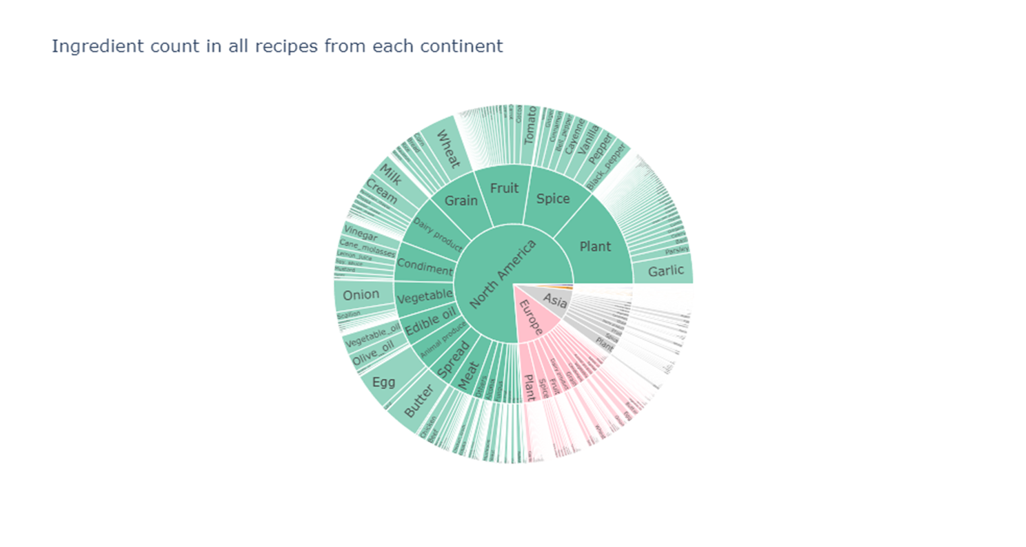
Ingredients count in all recipes from each Continent

Slide 7
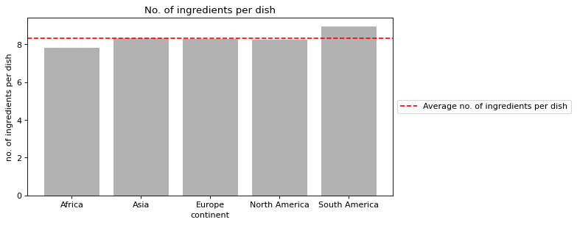
A look at the number of ingredients per dish

Slide 8
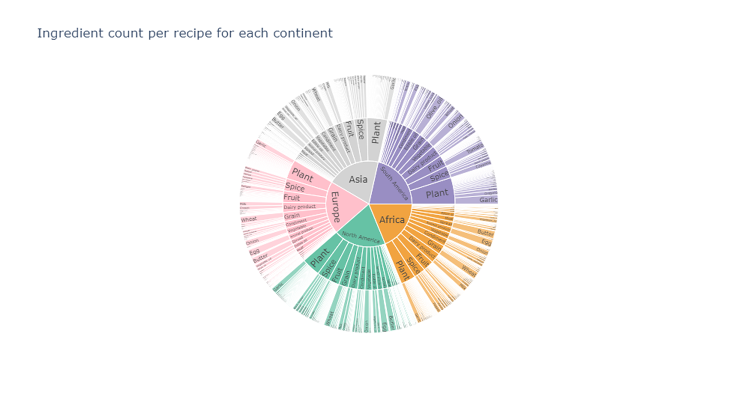
Ingredient's count

Slide 9
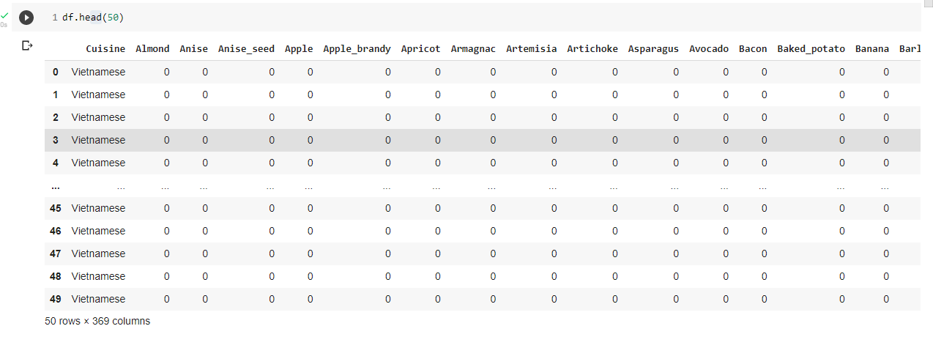
Feature Engineering

Slide 10
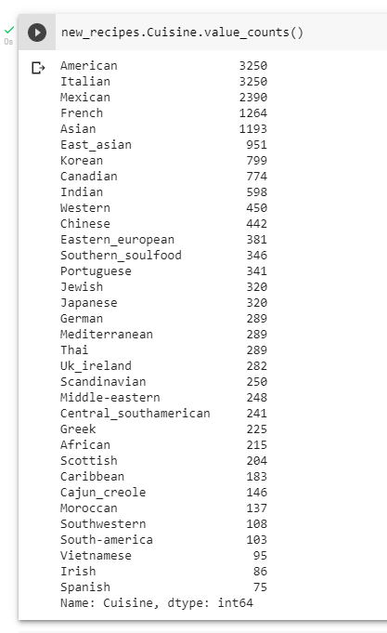
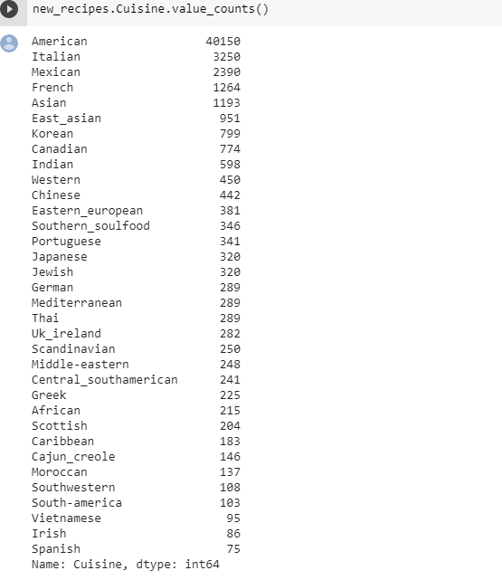
Feature Engineering

Slide 11
Algorithms Explored
Decision Tree Classifier
Random Forest Classifier
Multi Layer Perceptron Classifier
Extra Tree Classifier
xGBoost Classifier
Algorithms
Decision Tree Classifier
Random Forest Classifier
Multi Layer Perceptron Classifier
Extra Tree Classifier
xGBoost Classifier

Slide 12
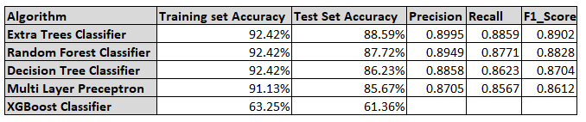
RESULT

Slide 13
RECOMMENDATION
More recipes could be acquired for countries that were the minority classes which had to be oversampled to balance the dataset.

